Slide 1
CSCI 3301: Computer Organization
Abdullah Yasin Nur

Slide 2
Topic Coverage
Chapters
Computer Abstraction and Technology
Instructions: Language of the Computer
Arithmetic for Computers
The Processor
Large and Fast: Exploiting Memory Hierarchy
Parallel Processors from Client to Cloud

Slide 3
Chapter 1
Computer Abstractions and Technology

Slide 4
The Computer Revolution
§1.1 Introduction
Progress in computer technology
Underpinned by Moore’s Law
Makes novel applications feasible
Computers in automobiles
Cell phones
Human genome project
World Wide Web
Search Engines
Computers are pervasive

Slide 5
Classes of Computers
Personal computers
General purpose, variety of software
Subject to cost/performance tradeoff
Server computers
Network based
High capacity, performance, reliability
Range from small servers to building sized

Slide 6
Classes of Computers
Supercomputers
High-end scientific and engineering calculations
Highest capability but represent a small fraction of the overall computer market
Embedded computers
Hidden as components of systems
Stringent power/performance/cost constraints

Slide 7
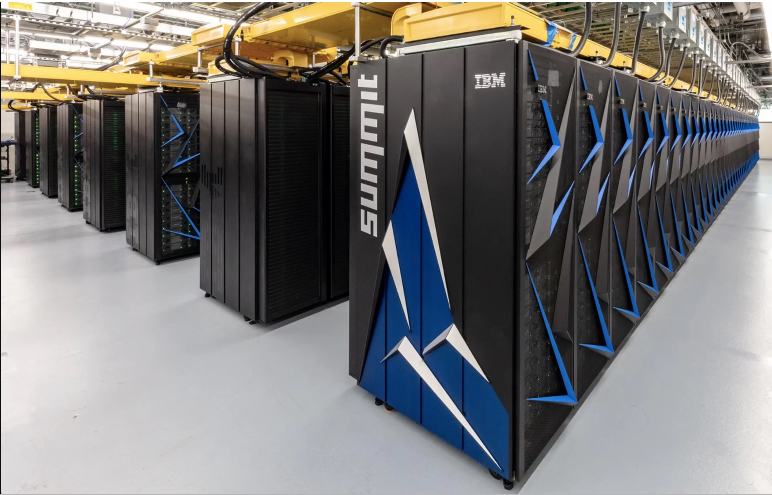
Supercomputers
America's latest supercomputer
Size of two tennis courts
Fastest supercomputer in the world
200,000 trillion calculations per second
"If every person on Earth completed one calculation per second, it would take the world population 305 days to do what Summit can do in 1 second“
Oak Ridge National Laboratory, Tennessee
https://www.ornl.gov/

Slide 8
Classes of Computers
Personal computers
Server computers
Supercomputers
Embedded computers

Slide 9
The PostPC Era
Personal Mobile Device (PMD)
Battery operated
Connects to the Internet
Hundreds of dollars
Smart phones, tablets, electronic glasses
Cloud computing
Warehouse Scale Computers (WSC)
Software as a Service (SaaS)
Portion of software run on a PMD and a portion run in the Cloud
Amazon and Google

Slide 10
How do computers work?
Applications software
Systems software
Assembly Language
Machine Language
Architectural Issues
Sequential logic, finite state machines
Combinational logic, Arithmetic circuits
Boolean logic, 1s and 0s
Transistors
Semiconductors – Silicon used to build transistors
Properties of atoms, electrons and quantum dynamics

Slide 11
What You Will Learn
How programs are translated into the machine language
And how the hardware executes them
The hardware/software interface
What determines program performance
And how it can be improved
How hardware designers improve performance
What is parallel processing

Slide 12
Understanding Performance
Algorithm
Determines number of operations executed
Programming language, compiler, architecture
Determine number of machine instructions executed per operation
Processor and memory system
Determine how fast instructions are executed
I/O system (including OS)
Determines how fast I/O operations are executed

Slide 13








Eight Great Ideas
Design for Moore’s Law
Use abstraction to simplify design
Make the common case fast
Performance via parallelism
Performance via pipelining
Performance via prediction
Hierarchy of memories
Dependability via redundancy
§1.2 Eight Great Ideas in Computer Architecture
Notes:
Moore's law is the observation that the number of transistors in a dense integrated circuit doubles about every two years.

Slide 14
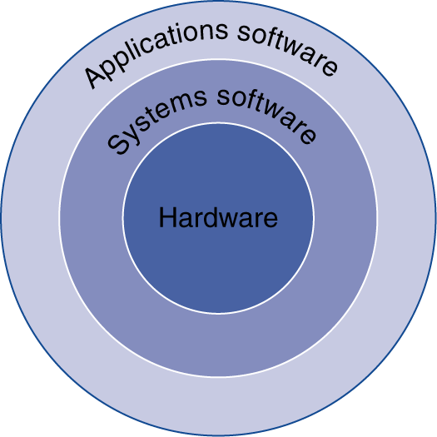
Below Your Program
Application software
Written in high-level language
System software
Compiler: translates HLL code to machine code
Operating System: service code
Handling input/output
Managing memory and storage
Scheduling tasks & sharing resources
Hardware
Processor, memory, I/O controllers
§1.3 Below Your Program
Notes:
Application > Algorithm > System Software > OS > ISA > Microarchitecture > Register Transfer Level (RTL) > Gates > Circuits > Devices > Physics

Slide 15
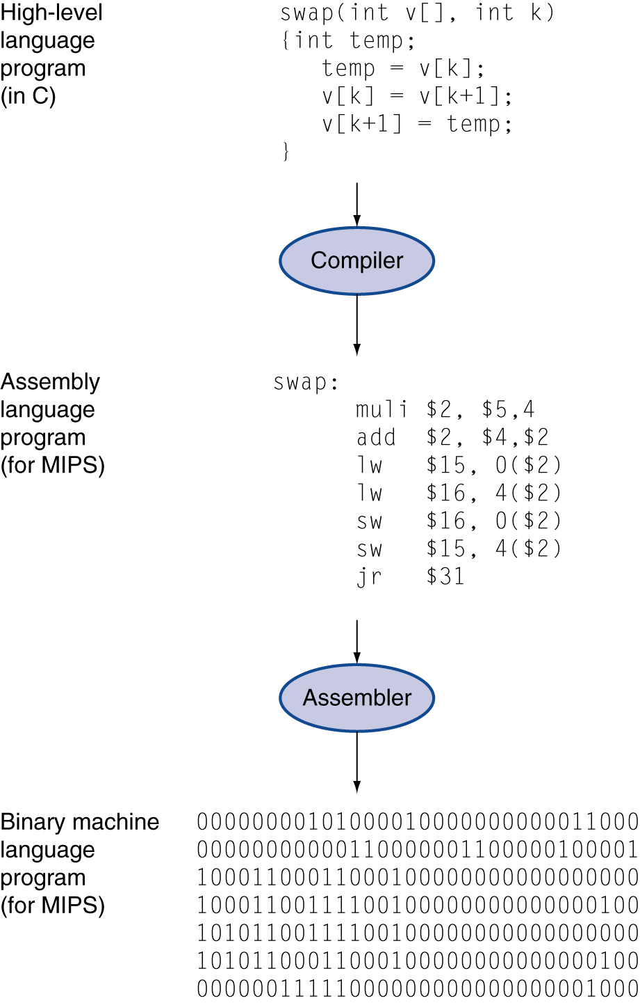
Levels of Program Code
High-level language
Level of abstraction closer to problem domain
Provides for productivity and portability
Assembly language
Textual representation of instructions
Hardware representation
Binary digits (bits)
Encoded instructions and data

Slide 16
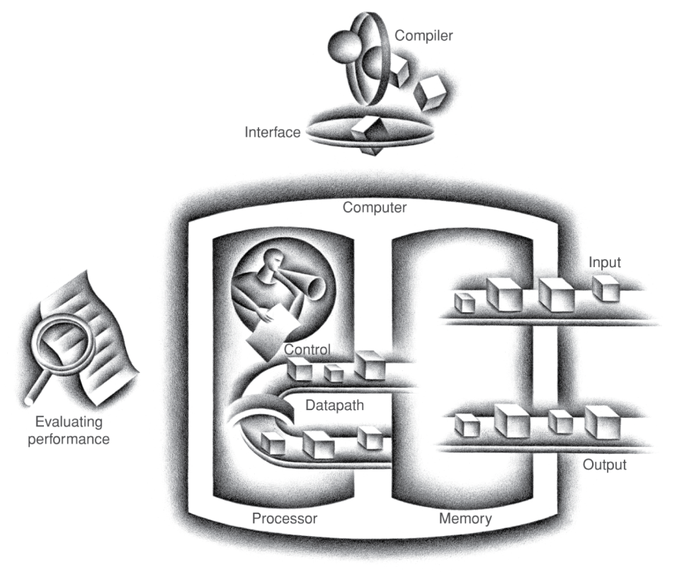
Components of a Computer
Same components for all kinds of computer
Desktop, server, embedded
Input/output includes
User-interface devices
Display, keyboard, mouse
Storage devices
Hard disk, CD/DVD, flash
Network adapters
For communicating with other computers
§1.4 Under the Covers
The BIG Picture

Slide 17

Touchscreen
PostPC device
Supersedes keyboard and mouse
Resistive and Capacitive types
Most tablets, smart phones use capacitive
Capacitive allows multiple touches simultaneously

Slide 18
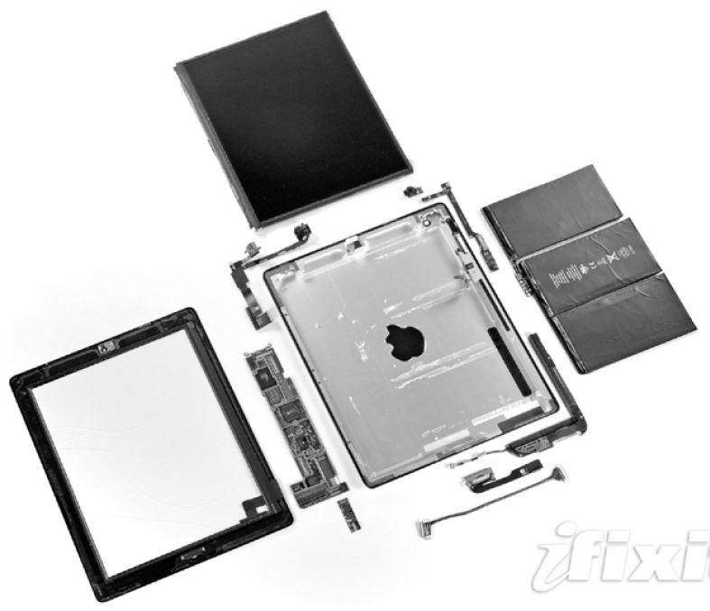
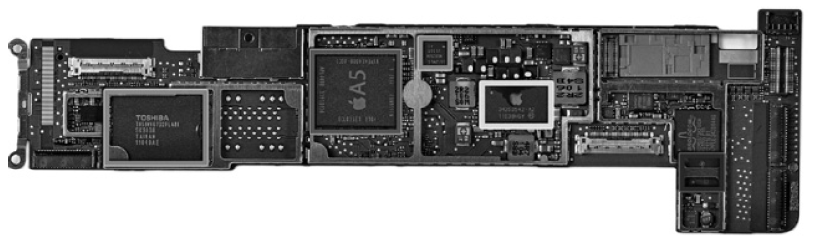
Opening the Box – Apple iPad 2 A1395
Capacitive multitouch LCD screen
3.8 V, 25 Watt-hour battery
Computer board

Slide 19
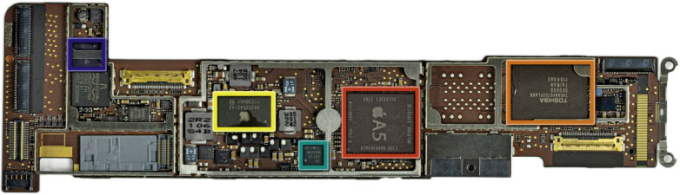
FIGURE 1.8 The logic board of Apple iPad 2 in Figure 1.7. The photo highlights five integrated circuits. The large integrated circuit in the middle is the Apple A5 chip, which contains a dual ARM processor cores.
Apple 1GHz A5 dual-core Processor with a 200MHz bus and 512 MB of Samsung manufactured RAM.
Toshiba TH58NVG7D2FLA89 16GB NAND Flash.
Power management chip
Texas Instruments CD3240B0 11AZ4JT G1 touchscreen line driver.
S6T2MLC N33C50V Power Management IC.
(Refernce: iFixit, www.ifixit.com)
19
Copyright © 2014 Elsevier Inc. All rights reserved.
Notes:
Logic printed circuit board:

Slide 20
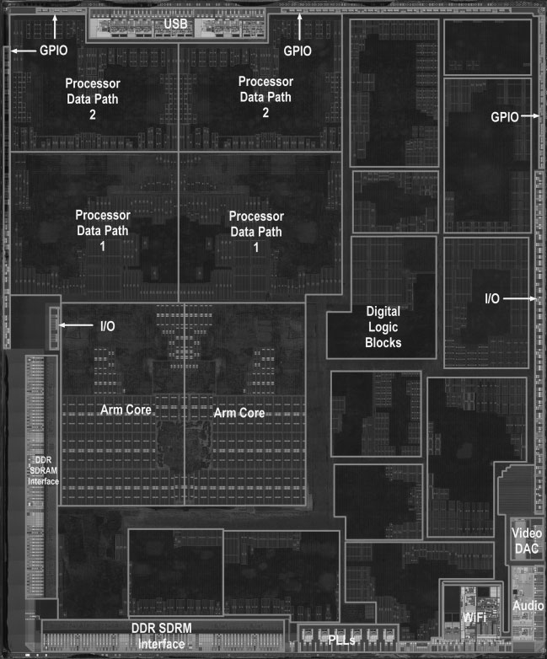
Apple A5
FIGURE 1.9 The processor integrated circuit inside the A5 package. The size of chip is 12.1 by 10.1 mm, and it was manufactured originally in a 45-nm process (see Section 1.5). It has two identical ARM processors or cores in the middle left of the chip and a PowerVR graphical processor unit (GPU) with four datapaths in the upper left quadrant. To the left and bottom side of the ARM cores are interfaces to main memory (DRAM). (Courtesy Chipworks, www.chipworks.com)
20
Copyright © 2014 Elsevier Inc. All rights reserved.
Notes:
ARM is a RISC (reduced instruction set computing) processor, which requires significantly fewer transistors compared to a typical processor. Thus, it is relatively light weighted and consumes less power.

Slide 21
Inside the Processor (CPU)
Datapath: performs operations on data
Control: sequences datapath, memory, ...
Cache memory
Small fast SRAM memory for immediate access to data

Slide 22
Memory Hierarchy
L1/L2 Cache
Registers
Main Memory
Secondary Storage
Magnetic Tape
Typical Access Time
Typical Capacity
1 nanosecond
< 1 KB
2 nanoseconds
32 KB/4 MB
10 nanoseconds
1 – 16 GB
10 milliseconds
128 - 2000 GB
100 seconds
500 - 1000 GB

Slide 23
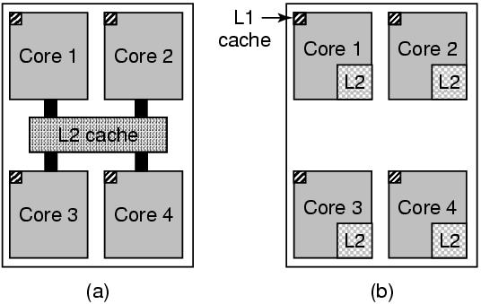
Multi-core Chips
Two or more cores on a single chip
How is this different from a true multi-processor?
Shared components
Cache (sometimes)
Interconnect
Cores can operate independently as with multi-processors
But there will be contention for any shared resources
Fig: (a) A quad-core chip with a shared L2 cache (e.g. Intel).
(b) A quad-core chip with separate L2 caches (e.g. AMD).
Tanenbaum, Modern Operating Systems 3 e, (c) 2008 Prentice-Hall, Inc. All rights reserved. 0-13-6006639

Slide 24
Abstractions
The BIG Picture
Abstraction helps us deal with complexity
Hide lower-level detail
Instruction set architecture (ISA)
The hardware/software interface
Application binary interface
The ISA plus system software interface
Implementation
The details underlying and interface

Slide 25
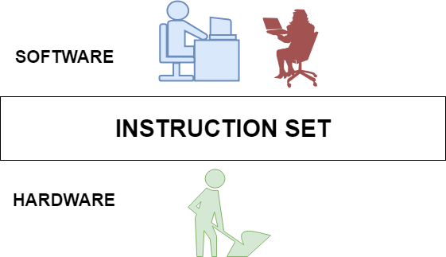
Instruction set architecture (ISA)
The hardware/software interface

Slide 26
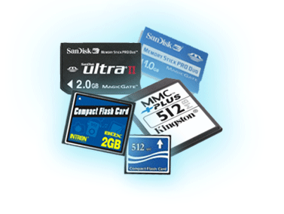
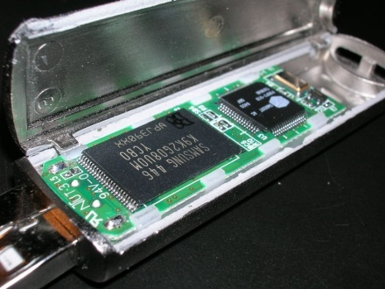
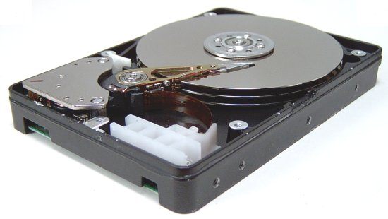
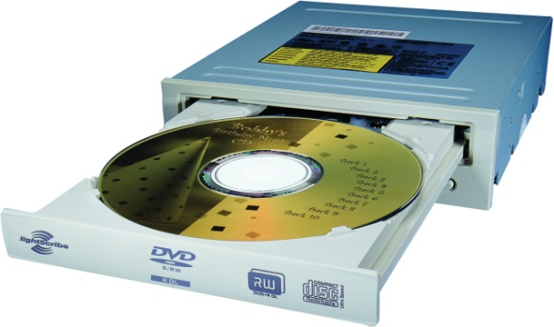
A Safe Place for Data
Volatile main memory
Loses instructions and data when power off
Non-volatile secondary memory
Magnetic disk
Flash memory
Optical disk (CDROM, DVD)

Slide 27
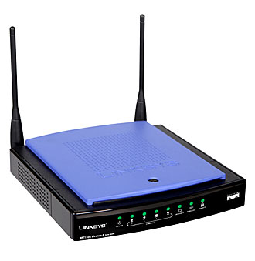
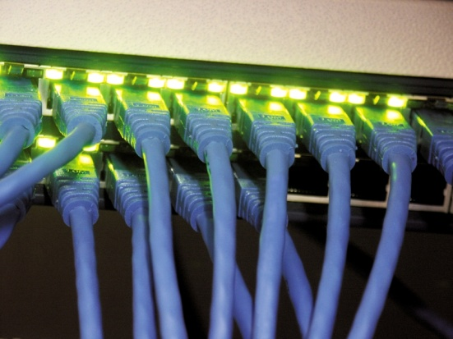
Networks
Communication, resource sharing, nonlocal access
Local area network (LAN): Ethernet
Wide area network (WAN): the Internet
Wireless network: WiFi, Bluetooth

Slide 28
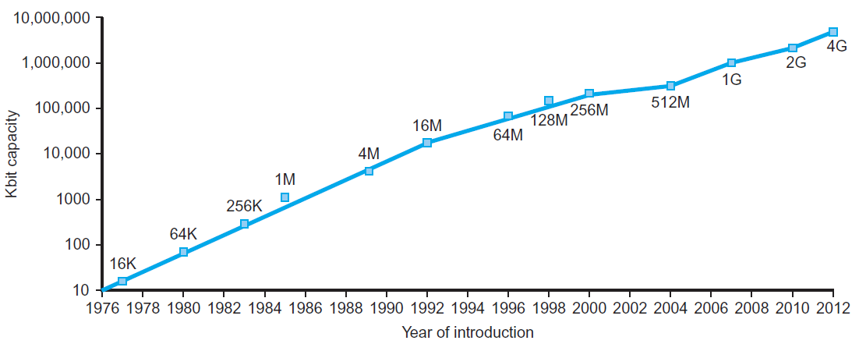
Technology Trends
Electronics technology continues to evolve
Increased capacity and performance
Reduced cost
§1.5 Technologies for Building Processors and Memory
DRAM capacity
Year | Technology | Relative performance/cost
1951 | Vacuum tube | 1
1965 | Transistor | 35
1975 | Integrated circuit (IC) | 900
1995 | Very large scale IC (VLSI) | 2,400,000
2013 | Ultra large scale IC | 250,000,000,000
Notes:
250,000,000,000 => 250 billions

Slide 29
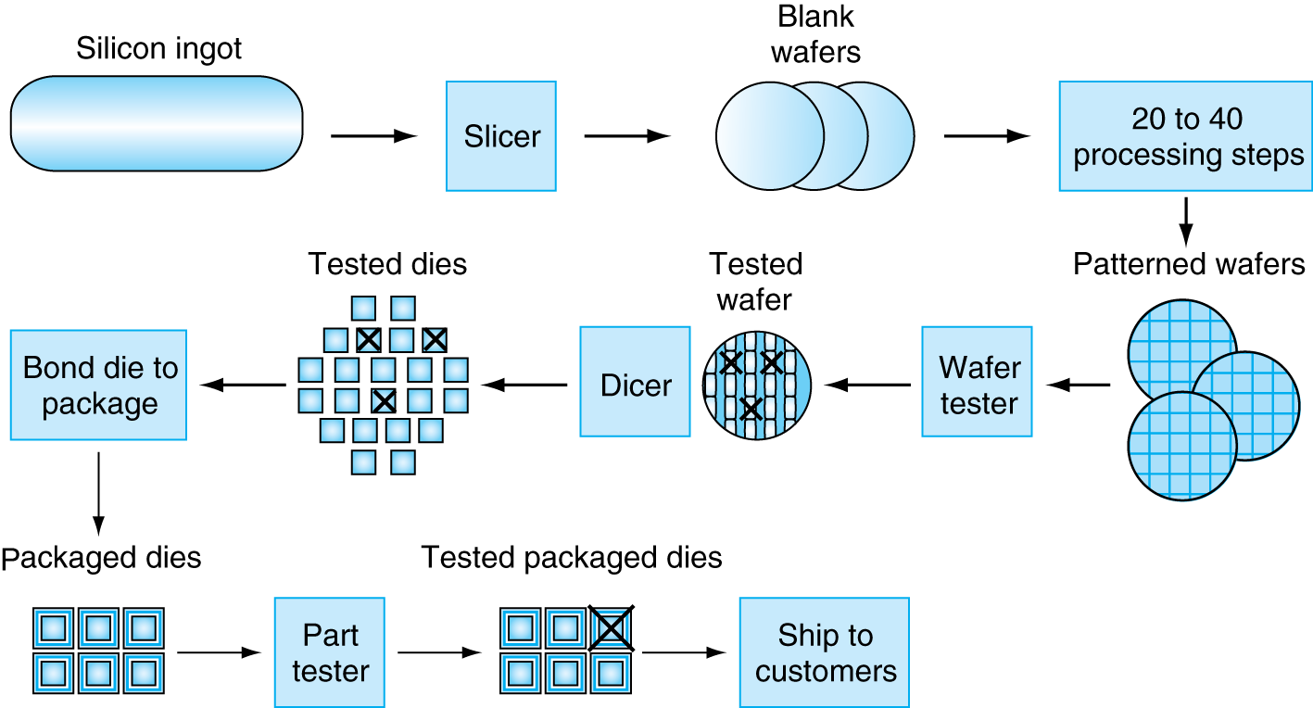
Manufacturing ICs
Self Study
Yield: proportion of working dies per wafer

Slide 30
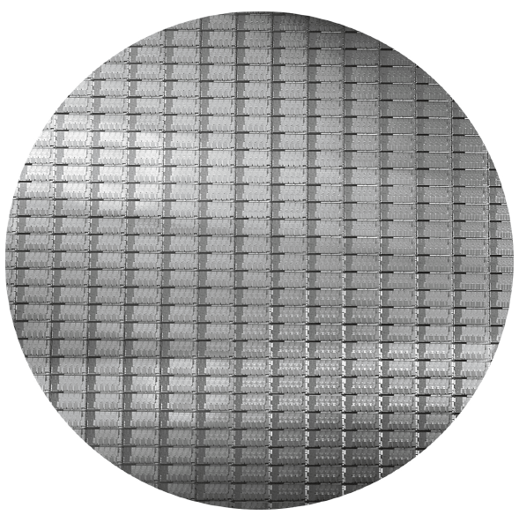
Intel Core i7 Wafer
Self Study
300mm wafer, 280 chips, 32nm technology
Each chip is 20.7 x 10.5 mm
Notes:
Note: The diameter of an atom ranges from about 0.1 to 0.5 nanometers.

Slide 31
Integrated Circuit Cost
Self Study
Nonlinear relation to area and defect rate
Wafer cost and area are fixed
Defect rate determined by manufacturing process
Die area determined by architecture and circuit design
Notes:
The discussion of the cost estimation is important here because the cost of the integrated circuits is much of the cost of the PMD. Thus, computer designers must understand the costs of chips to understand the costs of current computer.
Equation (2) or Dies per wafer can be more accurately approximated as:
Dies per wafer = [(pi × (Wafer radius)^2.0) /Die_Area ] – [(pi × Wafer_radius) / (2 x Die_area)^0.5 ]

Slide 32
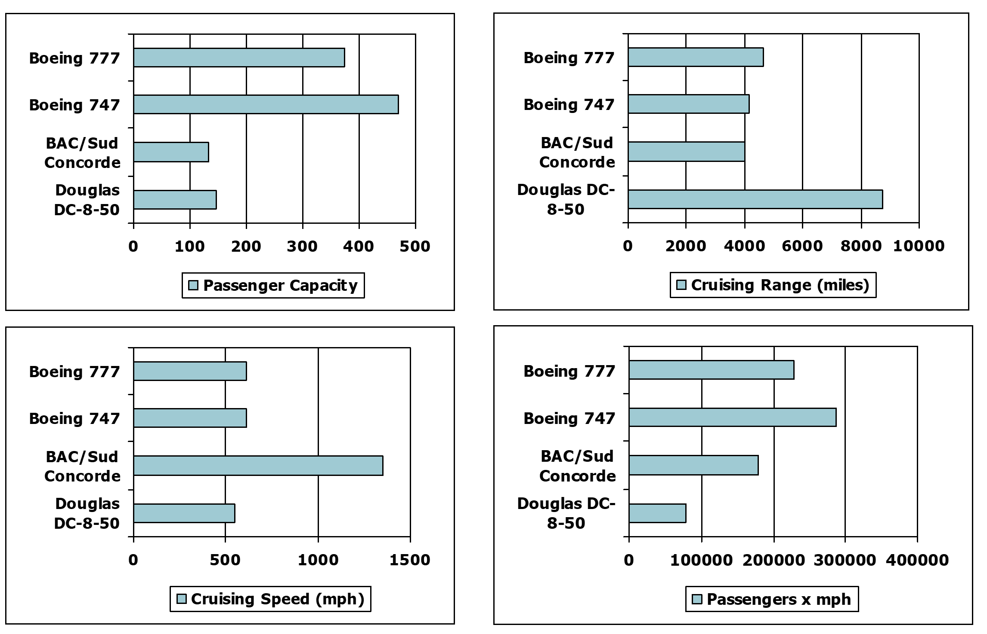
Defining Performance
§1.6 Performance
Which airplane has the best performance?

Slide 33
Response Time and Throughput
Response time
How long it takes to do a task
Throughput
Total work done per unit time
e.g., tasks/transactions/… per hour
How are response time and throughput affected by
Replacing the processor with a faster version?
Adding more processors?
We’ll focus on response time for now…
Notes:
Response time Also called execution time
Throughput Also called bandwidth
Answer:
Decreasing response time almost always improves throughput. Hence, in case 1, both response time and throughput are improved.
In case 2, no one task gets work done faster, so only throughput increases.

Slide 34
Relative Performance
Define Performance = 1/Execution Time
“X is n time faster than Y”
Example: time taken to run a program
10s on A, 15s on B
Execution Time_{B} / Execution Time_{A} = 15s / 10s = 1.5
So A is 1.5 times faster than B

Slide 35
Measuring Execution Time
Elapsed time
Total response time, including all aspects
Processing, I/O, OS overhead, idle time
Determines system performance
CPU time
Time spent processing a given job
Discounts I/O time, other jobs’ shares
Comprises user CPU time and system CPU time
Different programs are affected differently by CPU and system performance

Slide 36
CPU Clocking
Operation of digital hardware governed by a constant-rate clock
Clock period
Clock (cycles)
Data transfer and computation
Update state
Clock period: duration of a clock cycle
e.g., 250ps = 0.25ns = 250×10^{–12}s
Clock frequency (rate): cycles per second
e.g., 4.0GHz = 4000MHz = 4.0×10⁹Hz

Slide 37
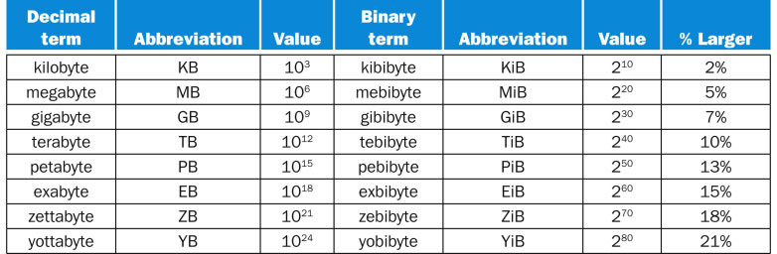
FIGURE 1.1 The 2^{X} vs. 10^{Y} bytes ambiguity was resolved by adding a binary notation for all the common size terms. In the last column we note how much larger the binary term is than its corresponding decimal term, which is compounded as we head down the chart. These prefixes work for bits as well as bytes, so gigabit (Gb) is 10⁹ bits while gibibits (Gib) is 2³⁰ bits.
Copyright © 2014 Elsevier Inc. All rights reserved.

Slide 38
CPU Time
Performance improved by
Reducing number of clock cycles
Increasing clock rate
Hardware designer must often trade off clock rate against cycle count

Slide 39
CPU Time Example
Computer A: 2GHz clock, 10s CPU time
Designing Computer B
Aim for 6s CPU time
Can do faster clock, but causes 1.2 × clock cycles
How fast must Computer B clock be?

Slide 40
Instruction Count and CPI
Instruction Count for a program
Determined by program, ISA and compiler
Average cycles per instruction
Determined by CPU hardware
If different instructions have different CPI
Average CPI affected by instruction mix

Slide 41
CPI Example
Computer A: Cycle Time = 250ps, CPI = 2.0
Computer B: Cycle Time = 500ps, CPI = 1.2
Same ISA
Which is faster, and by how much?
A is faster…
…by this much

Slide 42
CPI in More Detail
If different instruction classes take different numbers of cycles
Weighted average CPI
Relative frequency

Slide 43
CPI Example
Alternative compiled code sequences using instructions in classes A, B, C
Class | A | B | C
CPI for class | 1 | 2 | 3
IC in sequence 1 | 2 | 1 | 2
IC in sequence 2 | 4 | 1 | 1
Sequence 1: IC = 5
Clock Cycles = 2×1 + 1×2 + 2×3 = 10
Avg. CPI = 10/5 = 2.0
Sequence 2: IC = 6
Clock Cycles = 4×1 + 1×2 + 1×3 = 9
Avg. CPI = 9/6 = 1.5

Slide 44
Performance Summary
The BIG Picture
Performance depends on
Algorithm: affects IC, possibly CPI
Programming language: affects IC, CPI
Compiler: affects IC, CPI
Instruction set architecture: affects IC, CPI, T_{c}
Notes:
CPU Time = [(Dynamic) Code-Size] x [CPI] x [Cycle-Time]

Slide 45
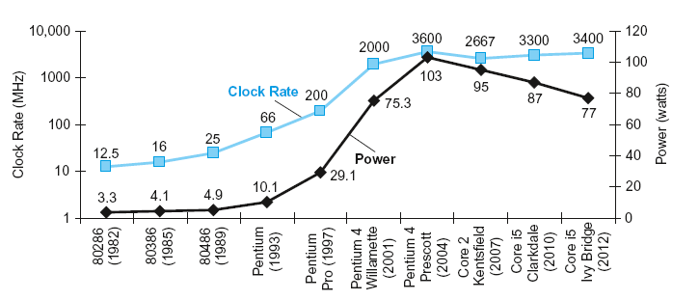
Power Trends
§1.7 The Power Wall
In CMOS IC technology
×30
5V → 1V
×1000
Notes:
103 Watts power is the limit for transistors. If we go up, we basically burn all the transistors.
We can use additional coolers to lower the temperature of transistors, but it consumes so much power. PostPc era devices are dependable to the battery. Also, it is expensive.

Slide 46
Reducing Power
Suppose a new CPU has
85% of capacitive load of old CPU
15% voltage and 15% frequency reduction
The power wall
We can’t reduce voltage further
We can’t remove more heat
How else can we improve performance?

Slide 47
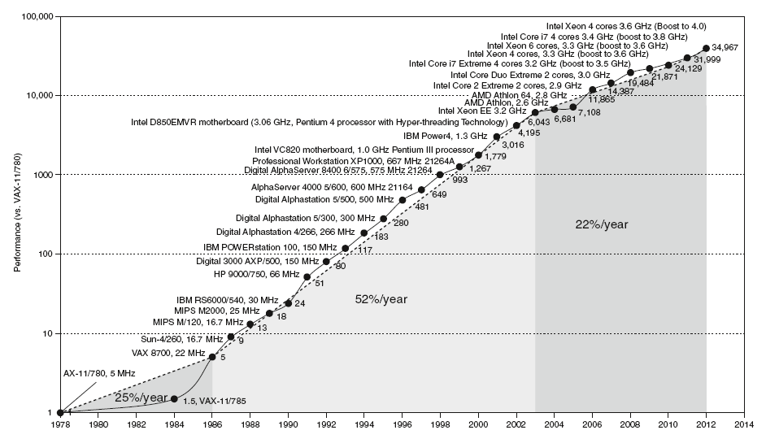
Uniprocessor Performance
§1.8 The Sea Change: The Switch to Multiprocessors
Constrained by power, instruction-level parallelism, memory latency

Slide 48
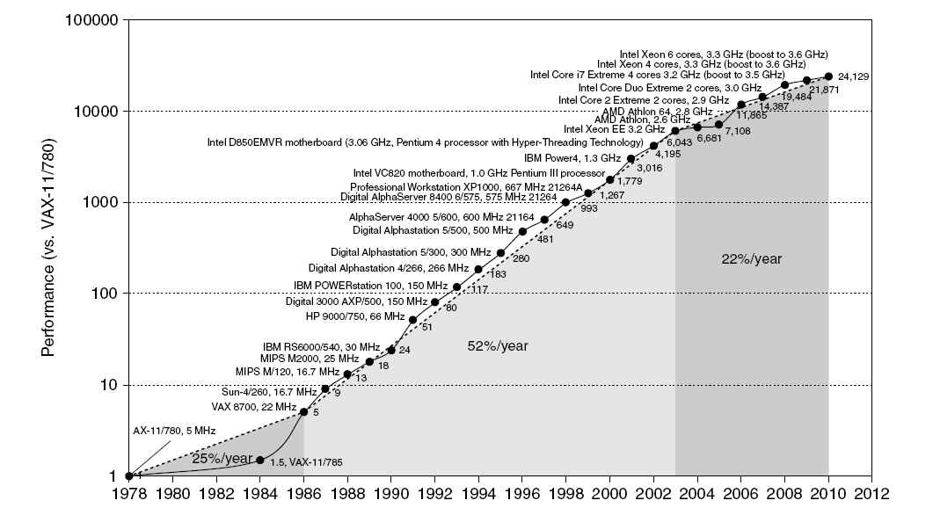
Uniprocessor Performance
Move to multi-processor
RISC
Notes:
Opening a new era. People need to start coding multithreaded codes to improve their software performance.

Slide 49
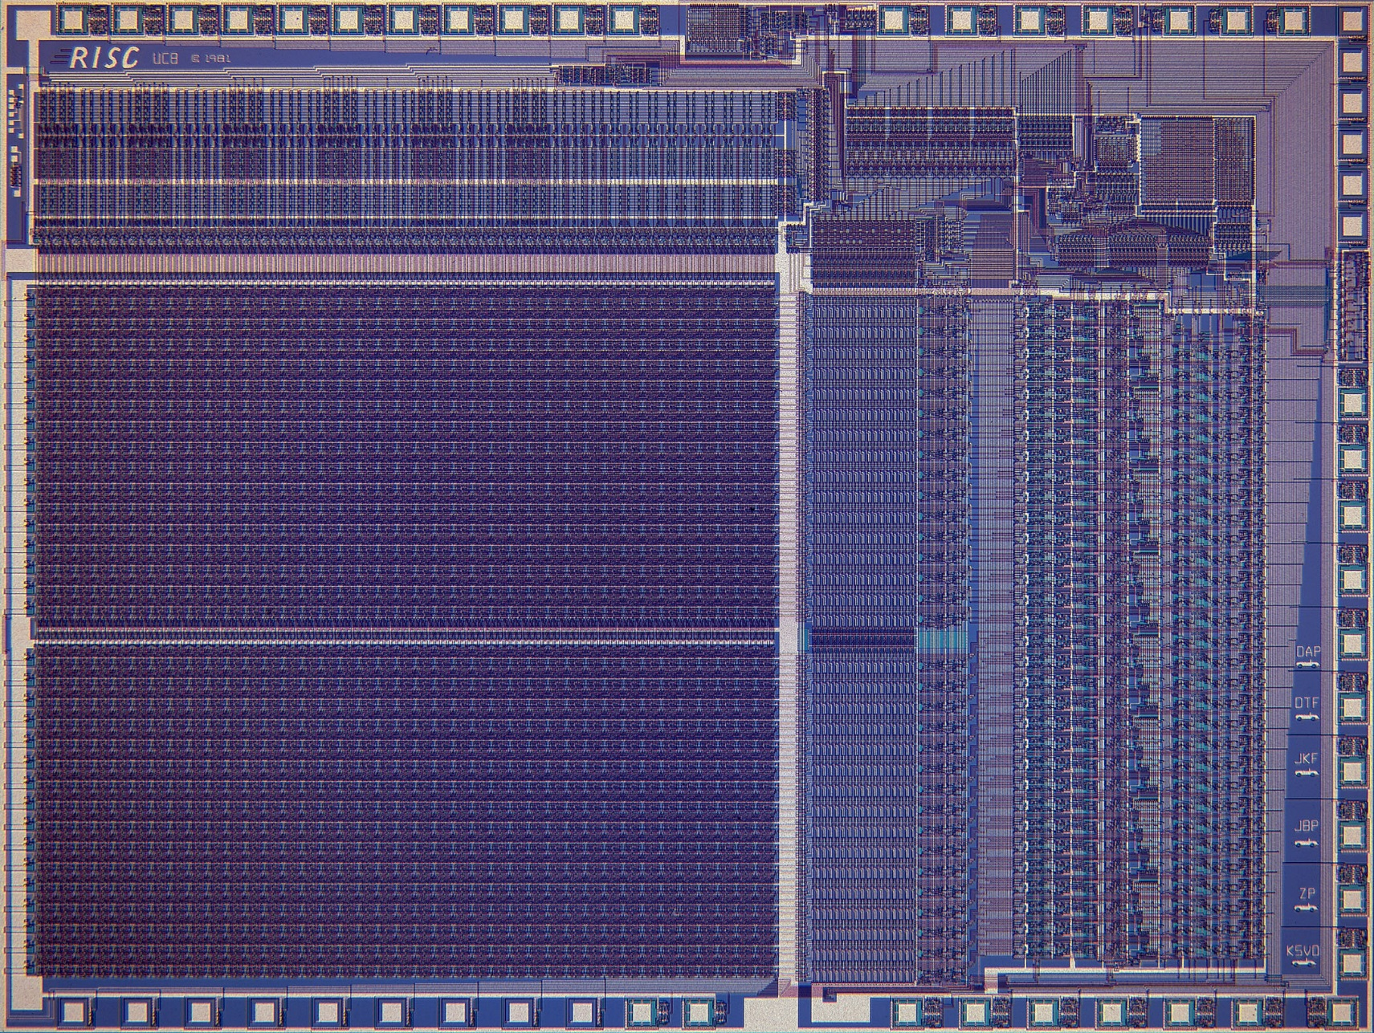
RISC-I: ~50,000 Transistors
Ref: http://www.cs.berkeley.edu/~pattrsn/Arch/RISC1.jpg
More: http://www.cs.berkeley.edu/~pattrsn/Arch/prototypes2.html
Notes:
Ref: http://www.cs.berkeley.edu/~pattrsn/Arch/prototypes2.html,
http://www.cs.berkeley.edu/~pattrsn/Arch/RISC1.jpg

Slide 50
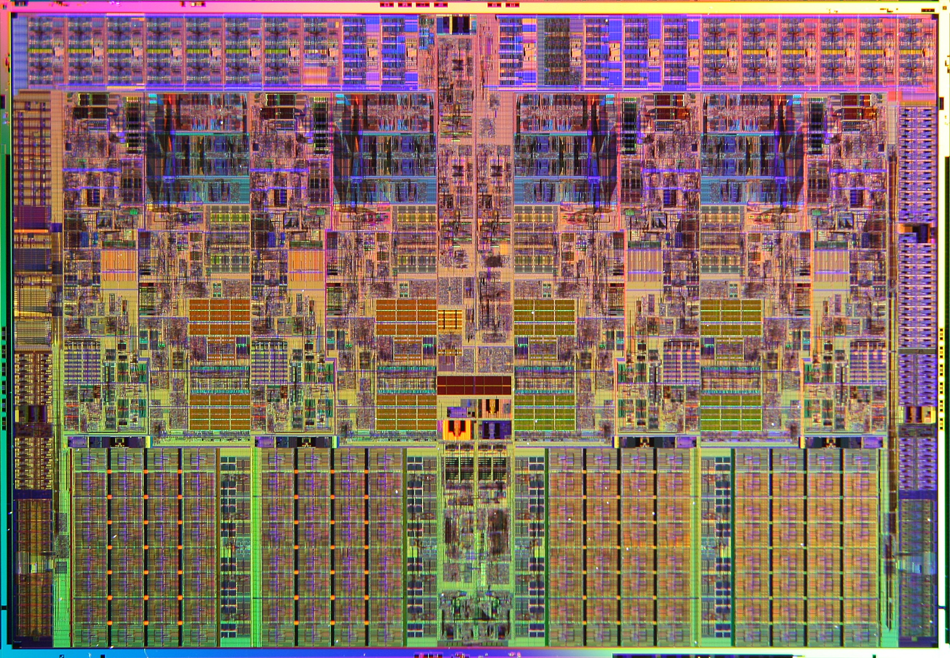
Intel Core i7: ~700 million Transistors
Figure: Intel Nehalem Processor, Core i7.
Notes:
Reference: http://download.intel.com/pressroom/kits/corei7/images/Nehalem_Die_Shot_3.jpg
Consists of 4 cores.
See http://en.wikipedia.org/wiki/List_of_Intel_Core_i7_microprocessors
According to Wikipedia, the largest transistor count in a commercially available single-chip processor is 19.2 billion AMD's Epyc

Slide 51
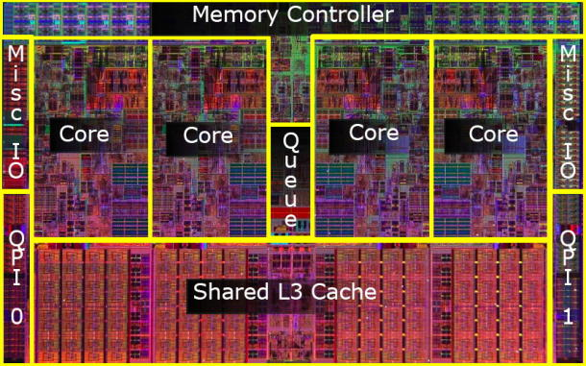
Floor plan of Core i7
Notes:
Reference: http://news.cnet.com

Slide 52
Multiprocessors
Multicore microprocessors
More than one processor per chip
Requires explicitly parallel programming
Compare with instruction level parallelism
Hardware executes multiple instructions at once
Hidden from the programmer
Hard to do
Programming for performance
Load balancing
Optimizing communication and synchronization

Slide 53
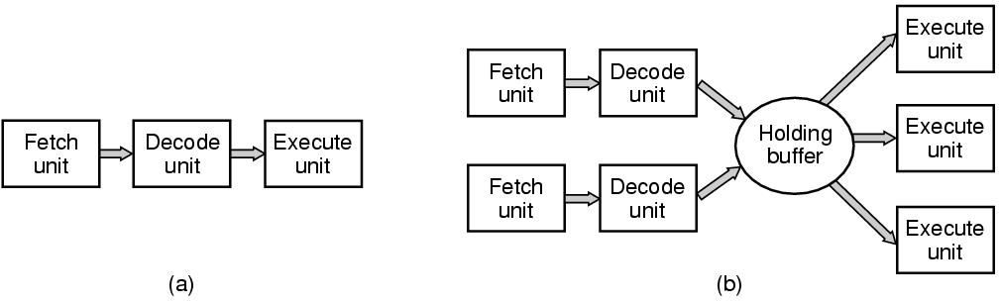
Instruction level parallelism by pipelining
CPU cycle:
The basic cycle of every CPU is to fetch, decode and execute subsequent instructions. The cycle is repeated until the program finished.
Pipelining for efficiency:
Figure. (a) A three-stage pipeline. (b) A superscalar CPU.
Tanenbaum, Modern Operating Systems 3 e, (c) 2008 Prentice-Hall, Inc. All rights reserved. 0-13-6006639

Slide 54
SPEC CPU Benchmark
Programs used to measure performance
Supposedly typical of actual workload
Standard Performance Evaluation Corp (SPEC)
Develops benchmarks for CPU, I/O, Web, …
SPEC CPU2006
Elapsed time to execute a selection of programs
Negligible I/O, so focuses on CPU performance
Normalize relative to reference machine
Summarize as geometric mean of performance ratios
CINT2006 (integer) and CFP2006 (floating-point)
Notes:
SPEC => Standard Performance Evaluation Cooperative
Benchmark is a measuring tool, special program which how long a computer takes the execute the program.
Idea: Use same benchmark in two different computer and compare their speed
Run the benchmark n times and take the geometric mean

Slide 55
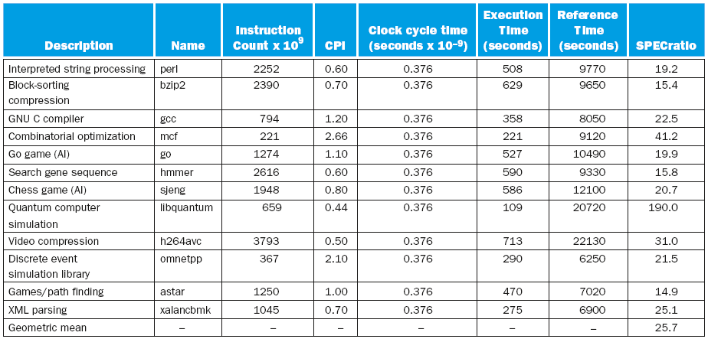
CINT2006 for Intel Core i7 920

Slide 56
SPEC Power Benchmark
Power consumption of server at different workload levels
Performance: ssj_ops/sec
Power: Watts (Joules/sec)
Notes:
ssj_ops => Server side Java operations per second.

Slide 57
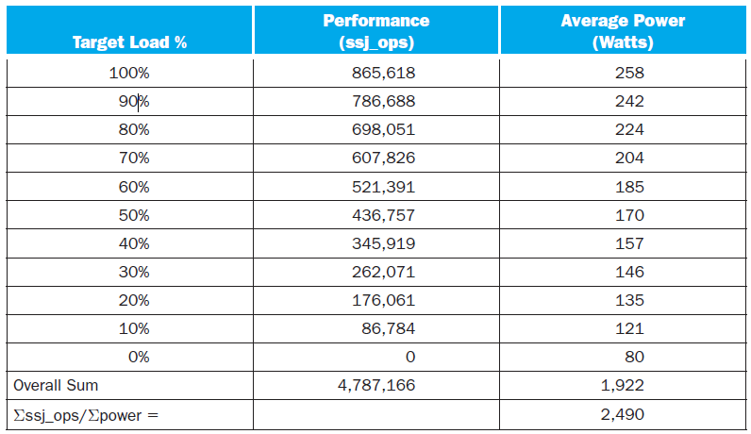
SPECpower_ssj2008 for Xeon X5650

Slide 58
Fallacy: Low Power at Idle
Xeon X5650 power benchmark (slide# 60)
At 100% load: 258W
At 50% load: 170W (66%)
At 10% load: 121W (47%)
Google data center
Mostly operates at 10% – 50% load
At 100% load less than 1% of the time
Consider designing processors to make power proportional to load
Notes:
Note: (170W x 100%) / 258W = 65.89% = 66%
(121W X100%) / 258W = 46.89% = 47%

Slide 59
Pitfall: Amdahl’s Law
Improving an aspect of a computer and expecting a proportional improvement in overall performance
§1.10 Fallacies and Pitfalls
Example: multiply operation accounts for 80s of 100s in a program
How much improvement in multiply performance to get 5× overall?
Can’t be done!
Corollary: make the common case fast
Notes:
Pitfalls => are only true in limited context.

Slide 60
Pitfall: MIPS as a Performance Metric
MIPS: Millions of Instructions Per Second
Doesn’t account for
Differences in ISAs between computers
Differences in complexity between instructions
CPI varies between programs on a given CPU

Slide 61
Concluding Remarks
Performance/Cost is improving
Due to underlying technology development
Hierarchical layers of abstraction
In both hardware and software
Instruction set architecture
The hardware/software interface
Execution time: the best performance measure
Power is a limiting factor
Use parallelism to improve performance
§1.9 Concluding Remarks
Notes:
You got to look ahead and see where is the future going and get there to be ready before it gets there
Dr. William Sawyer

Slide 62
Q & A
(#1.5) Consider three different processors P1, P2, and P3 executing the same instruction set. P1 has a 3 GHz clock rate and a CPI of 1.5. P2 has a 2.5 GHz clock rate and a CPI of 1.0. P3 has a 4.0 GHz clock rate and has a CPI of 2.2.
Which processor has the highest performance expressed in instructions per second?
Ans: performance of P1 (instructions/sec) = 3 × 10⁹ / 1.5 = 2 × 10⁹
performance of P2 (instructions/sec) = 2.5 × 10⁹ / 1.0 = 2.5 x 10⁹
performance of P3 (instructions/sec) = 4 × 10⁹ / 2.2 = 1.8 × 10⁹
^{Thus, P2 > P1 > P3.}
Notes:
Note: we saw MIPS = (Clock-rate) / (CPI x 10^6), so here it should be = clock-rate / cpi

Slide 63
Q & A (…1.5)
If the processors each execute a program in 10 seconds, find the number of cycles and the number of instructions.
Ans:
cycles(P1) = 10 × 3 × 10⁹ = 30 × 10⁹ cycles
cycles(P2) = 10 × 2.5 × 10⁹ = 25 × 10⁹ cycles
cycles(P3) = 10 × 4 × 10⁹ = 40 × 10⁹ cycles
No. instructions (P1) = 30 × 10⁹/1.5 = 20 × 10⁹
No. instructions (P2) = 25 × 10⁹/1 = 25 × 10⁹
No. instructions (P3) = 40 × 10⁹/2.2 = 18.18 × 10⁹
Notes:
Execution time = Cycles / clock-rate
Or, Cycles = Exe-time x clock-rate

Slide 64
Q & A (…1.5)
We are trying to reduce the time by 30% but this leads to an increase of 20% in the CPI. What clock rate should we have to get this time reduction?
Ans:
CPI_{new} = CPI_{old} × 1.2,
then CPI(P1) = 1.8, CPI(P2) = 1.2, CPI(P3) = 2.64.
Clock-rate, f = No. instr. × CPI/time, then
f (P1) = (2 × 10⁹ ×1.8)/ (0.7) = 5.14 GHz
f (P2) = (2.5 × 10⁹ × 1.2) / (0.7) = 4.28 GHz
f (P3) = (1.8 × 10⁹ × 2.64) / (0.7) = 6.78 GHz
Notes:
Or, You can solve as following for P1:
CPI_new = CPI_old 1.2
CPU_Time_new = 0.7 CPU_Time_old
Clock-rate_new = ? Clock-rate_old = 3GHz
I x CPI_new 1.2 x CPI_old
Clock-rate_new ---------------------------- -----------------------
CPU_Time_New 0.7 CPU_Time_old 1.2
------------------- = -------------------------------- = ----------------------------- = -------
I x CPI_old CPI_old 0.7
Clock-rate_old ---------------------------- -------------------------
CPU_Time_old CPU_Time_old
1.2 1.2
=> Clock-rate_new = ------ x Clock-rate_old = -------- x 3 GHz = 5.142 … GHz
0.7 0.7

Slide 65
Q & A
(#1.6) Consider two different implementations of the same instruction set architecture. The instructions can be divided into four classes according to their CPI (class A, B, C, and D). P1 with a clock rate of 2.5 GHz and CPIs of 1, 2, 3, and 3, and P2 with a clock rate of 3 GHz and CPIs of 2, 2, 2, and 2.
Given a program with a dynamic instruction count of 1.0E6 instructions divided into classes as follows: 10% class A, 20% class B, 50% class C, and 20% class D, which implementation is faster?
What is the global CPI for each implementation?
Notes:
Note: The dynamic instruction count is the actual number of instructions executed by the CPU for a specific program execution.
and the static instruction count is the number of instruction the program has.

Slide 66
Q & A (… 1.6)
Class A: 10⁵ instr. [Since 10% of 10⁶ = 10⁵]
Class B: 2 × 10⁵ instr. [Since 20% of 10⁶ = 2 × 10⁵, etc.]
Class C: 5 ×10⁵ instr.
Class D: 2 × 10⁵ instr.
Time = No. instr. × CPI/clock rate
Total time P1 = (10⁵ + 2 ×10⁵ × 2 + 5 × 10⁵ × 3 + 2 × 10⁵ × 3)/(2.5 ×10⁹) = 10.4 × 10⁻⁴ s
Total time P2 = (10⁵ × 2 + 2 × 10⁵ × 2 + 5 × 10⁵ × 2 + 2 × 10⁵ × 2)/(3 × 10⁹) = 6.66 × 10⁻⁴ s
CPI (P1) = 10.4 × 10⁻⁴ × 2.5 × 10⁹/10⁶ = 2.6 [Since, Time = Cycles × Cycle-time,]
CPI (P2) = 6.66 × 10⁻⁴ × 3 × 10⁹/10⁶ = 2.0 [therefore, Cycles = Time × Clock-rate]
Notes:
Alternatively:
Total Clock-Cycle 1, CC1 = Σ (I x CPI) = (10⁵ + 2 ×10⁵ × 2 + 5 × 10⁵ × 3 + 2 × 10⁵ × 3) = (1+4+15+6) x 10⁵= 26 x 10⁵
Total Clock-Cycle 2, CC2 = Σ (I x CPI) = (10⁵ × 2 + 2 × 10⁵ × 2 + 5 × 10⁵ × 2 + 2 × 10⁵ × 2) = (2+4+10+4) x 10⁵= 20 x 10⁵
Global or Average CPI1 = CC1 / Total Instructions (I) = (26 x 10⁵)/ 10⁶= 2.6.
Global or Average CPI1 = CC2 / Total Instructions (I)= (20 x 10⁵)/ 10⁶= 2.0.

Slide 67
Q & A (… 1.6)
Find the clock cycles required in both cases.
Ans:
Since, CPI × No. Instr = Cycles, therefore,
clock cycles (P1) = 10⁵ × 1+ 2 × 10⁵ × 2 + 5 × 10⁵ × 3 + 2 × 10⁵ × 3 = 26 × 10⁵
clock cycles (P2) = 10⁵ × 2 + 2 × 10⁵ × 2 + 5 × 10⁵ × 2 + 2 × 10⁵ × 2 = 20 × 10⁵

Slide 68
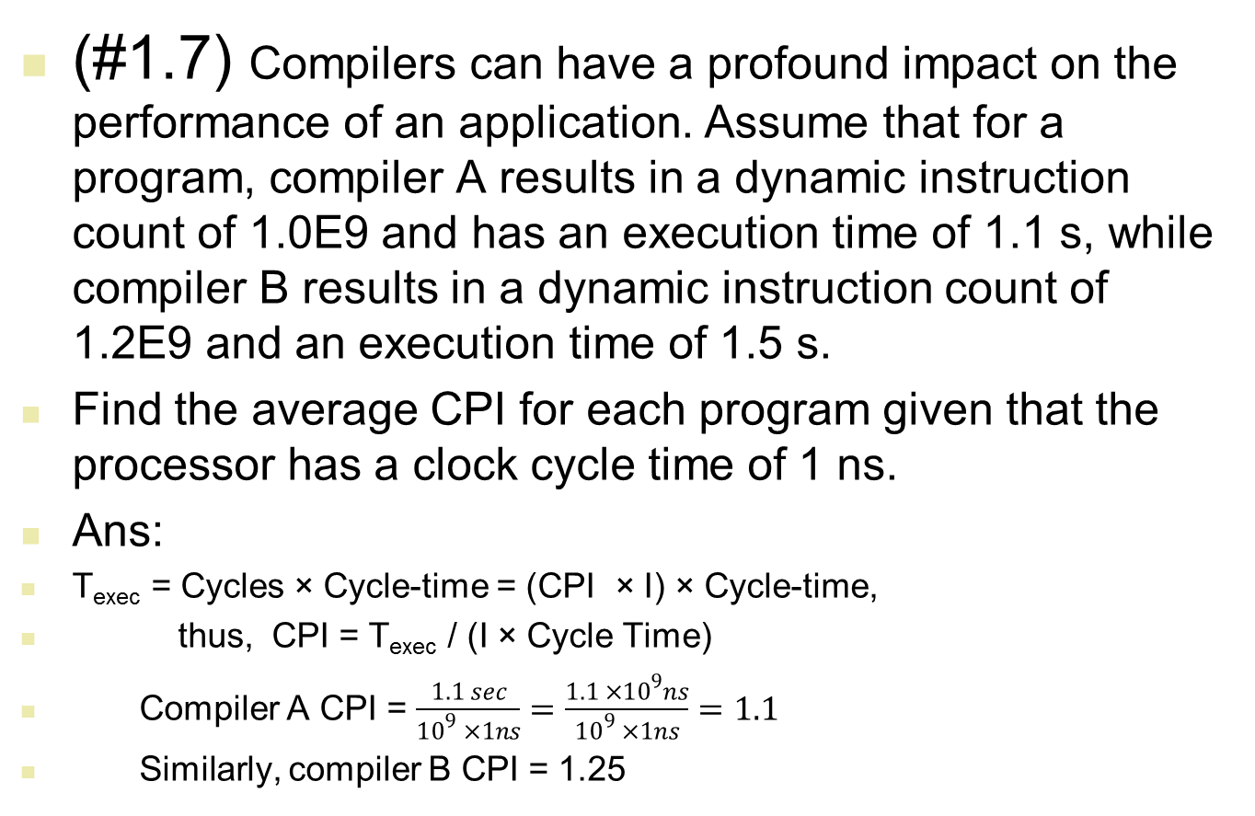
Q & A
Notes:
1.5 / 1.2 = 1.25

Slide 69
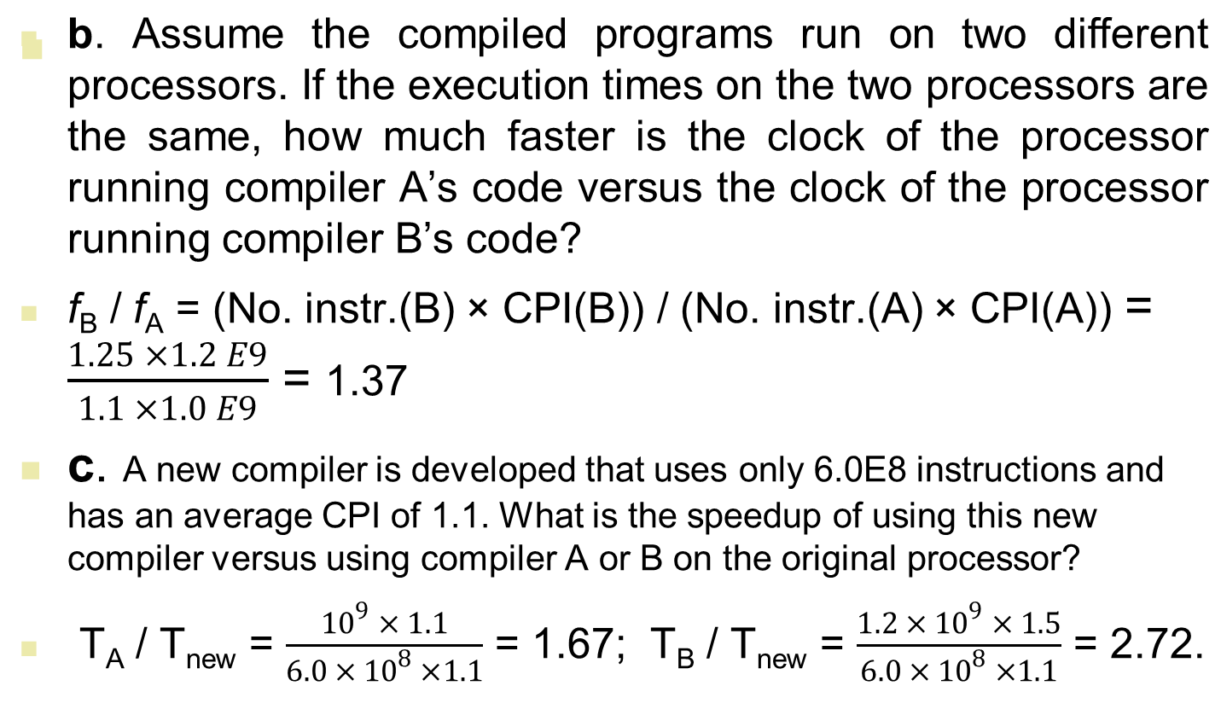
Q & A (… 1.7)
Notes:
Note: Ta(exec)= Tb(exec)
[CPIa x Ia/fa] = [CPIb x Ib/fb]
fb/fa = [CPIb x Ib] / [CPIa x Ia]
fb/fa = 1.37
==================
[CPIb x Ib] / CRb Tb/Tn = -------------------------- [CPIn x In] / CRn [Note: CRb=CRn] [CPIb x Ib] = ------------------------ [CPIn x In] 1.25 x 1.2 E9 = ------------------ 1.1 x 6E8 1.5 x E9 15 = ---------------- = --------- = 2.27... 6.6 x E8 6.6

Slide 70
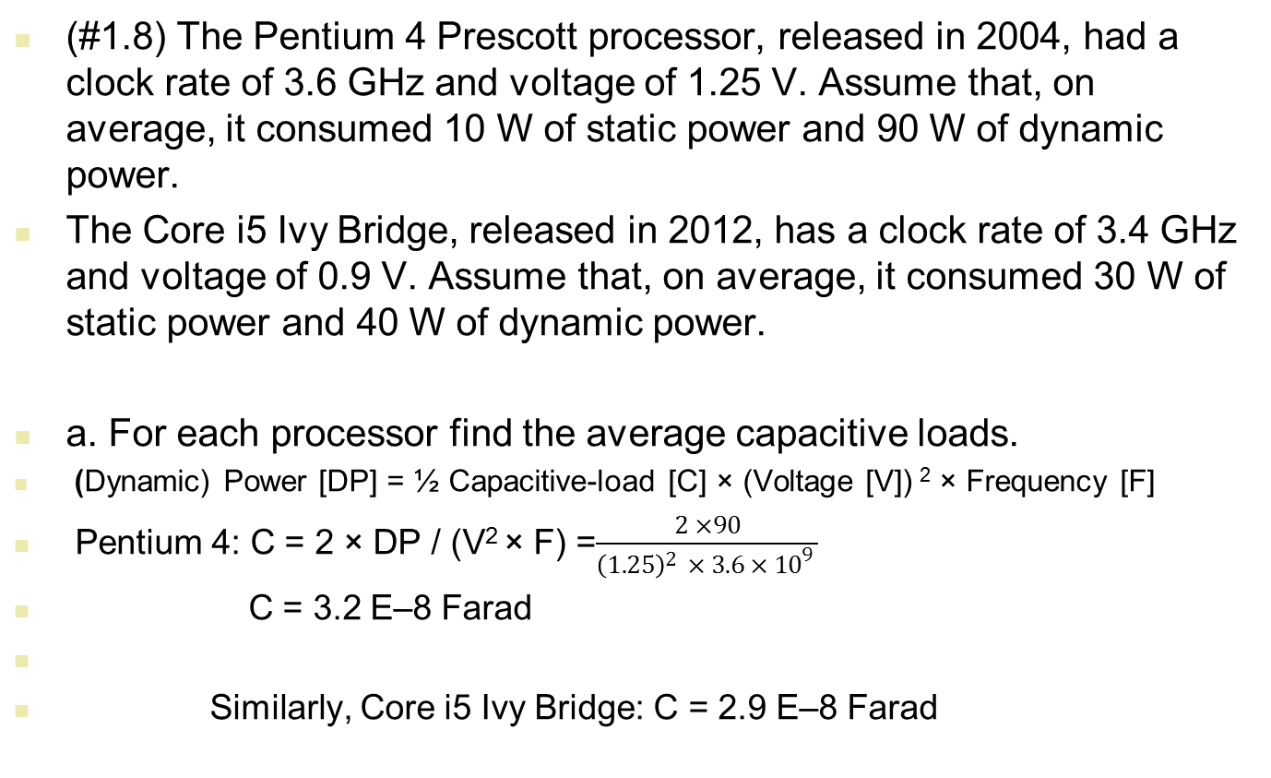
Q & A

Slide 71
Q & A (… 1.8)
b. For each processor, find the percentage of the consumed static power with respect to the total consumed power.
.
Pentium 4: 10/100 = 10%
Core i5 Ivy Bridge: 30/70 = 42.9%

Slide 72
Q & A
Q: How did the development of the transistor affect computers? What did the transistor replace?
Ans:
The development of transistor has had a tremendous impact on bringing the computer to our homes in the form of PCs and more recently into our hands (Personal Digital Assistants etc). The ability to package and integrate transistors on a chip at a rate that has been increasing exponentially according to Moore’s Law has resulted in tremendous performance gains for programs without having to change any of them.
The transistor replaced the vacuum tube in 1951.

Slide 73
Q & A
(Amdahl’s law question) suppose you have a machine which executes a program consisting of 50% floating point multiply, 20% floating point divide, and the remaining 30% are from other instructions.
(a) Management wants the machine to run 4 times faster. You can make the divide run at most 3 times faster and the multiply run at most 8 times faster. Can you meet management’s goal by making only one improvement, and which one?
Ans: (a) Amdahl’s Law states:
Execution time after improvement =
(Execution time affected by improvement)/(Amount of Improvement) +
Execution time unaffected.

Slide 74
Q & A
Assuming initially that the floating point multiply, floating point divide and the other instructions had the same CPI:
i) Execution time after Improvement with Divide = (20)/3 + (50 + 30) = 86.67
ii) Execution time after Improvement with Multiply = (50)/8 + (20 + 30) = 56.25
So what do you think?
(b) Bob has now taken over the company removing all the previous managers. If you make both the multiply and divide improvements, what is the speed of the improved machine relative to the original machine?
If we make both the improvements,
Execution time after Improvement = (50)/8 + (20)/3 + (30) = 42.91
The speedup relative to the original machine = (100)/(42.91) = 2.33

